Slide 1

Exploring a NS Digitization Strategy
@ The Beaton Institute
Catherine Arseneau
Director

Slide 2
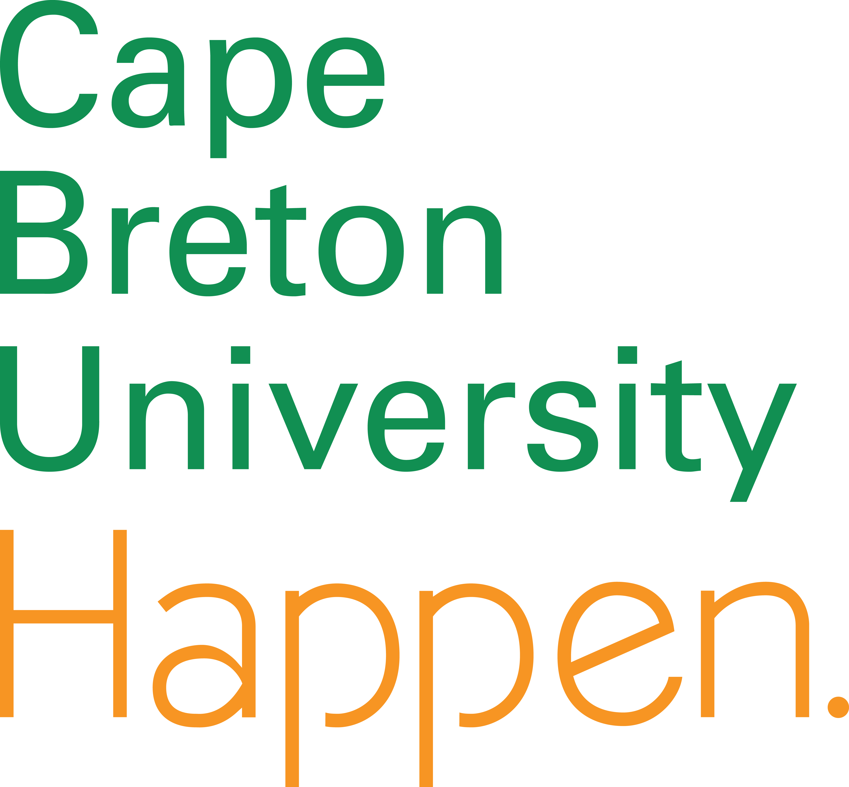
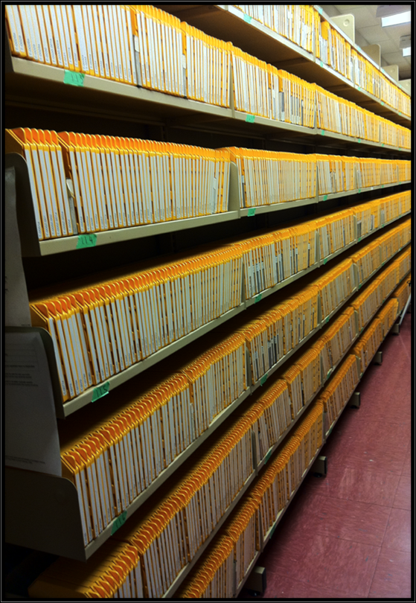
The Beaton Institute:
a cultural heritage archive mandated to preserve the social, economic, political and cultural history of Cape Breton Island.
the official repository for the historically significant records of CBU.
2.5 km of archival holdings:
3500 manuscript collections
300 000+ images
5500 sound recordings
2000 videos and films
3000 reference books
3500 maps and plans
Notes:
The Beaton Institute is the regional archive for Cape Breton Island, containing business, cultural, religious, environmental, industrial, genealogical and university records.
The Beaton Institute was first known as the Cape Bretoniana Collection. It was founded by Sr. Margaret Beaton who was also the librarian Xavier Junior College. She began collecting archival material in 1957.
Today:
we are the 2nd largest archive in NS
2.5 km of accessible archival material
University archives
Research Institute

Slide 3
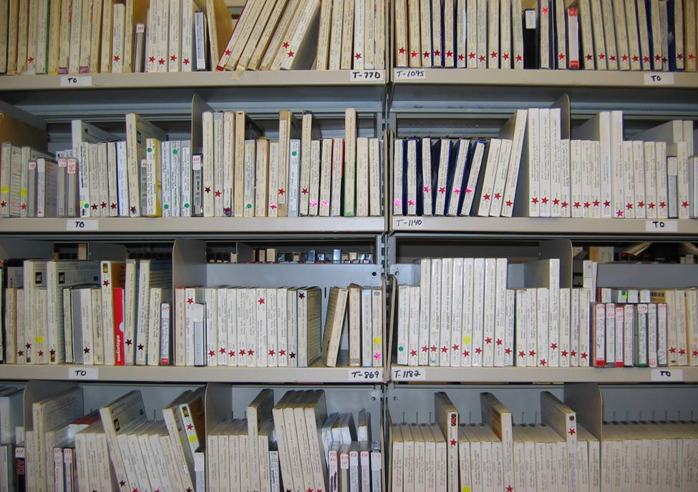
Evolution towards Digitization
Analogue to Digital:
Goal: access and preservation
Process: evolution through project based initiatives
Outcome: project-based to operational practice
Insights: partnerships, funding and infrastructure (technical and human)
How to get to the next level?
Notes:
Although born digital records and electronic records management is something we are working towards, currently the expectation from patrons, faculty and community is pushing the Beaton Institute to provide more access to digital content. We manage this content on a daily basis.
Status: 2006 the status of the AV collection was:
There had been a moratorium upon acquisitions of audio-visual material to the Beaton Institute
The AV materials had been boxed and closed to the public for use
CBU had invested in Intangible Culture with new teaching faculty offering courses in Ethnomusicology, Folklore, Celtic Studies, Celtic Music, and Gaelic Language
Dr. Richard MacKinnon was awarded the prestigious Tier 1 Canada Research Chair in Intangible Cultural Heritage (2007)
Centre for Cape Breton Studies: Digitization Lab & Performance Room under development
The University Administration are convinced to hired both a Manager and an Archivist at the Beaton Institute

Slide 4

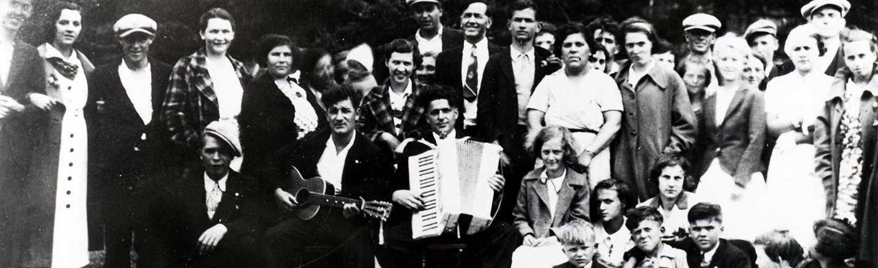
Ethno-cultural Resources Inventory: 2008
From Analogue to Digital Trial:
NADP funding
Equipment purchases
Contentdm trial
Skill development (metadata, file conversion , naming standards)
Partners:
NADP
CBU Library
Memorial University
Notes:
2007-2008 – Started planning for the Future - an SDI funded strategic plan identified strengths and weaknesses, provided the Beaton with a new manadate and helped to identifying digitization as essential to the workflow and operation of the Beaton.
2007-2008 – The Ethno-Cultural Resources Inventory really tested the waters as far as digitization is concerned. Metadata creation using Dublin Core and working with Memorial University and CBU Library for assistance. Contentdm allowed us to try and at times fail at this work but it was a step forward.

Slide 5

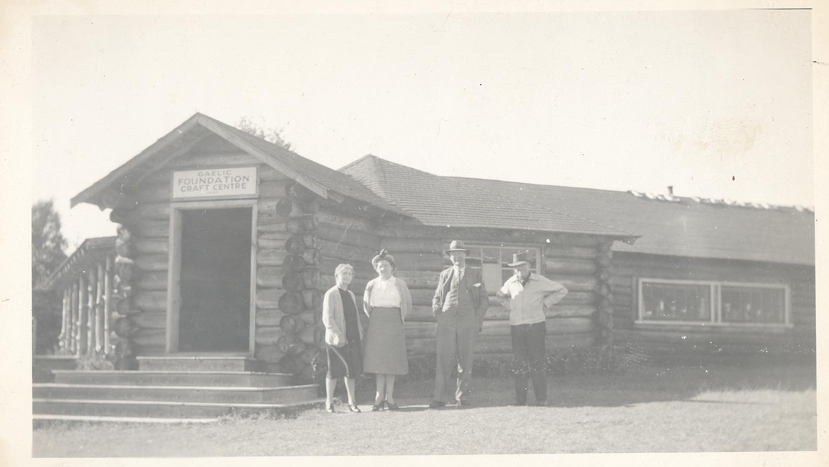
MacDermaid Stories & Songs - 2009
Trial AV Digitization
Av Trust Funding
Strategy to migrate AV recordings
Policy & procedures using recognized standards
Skill development
Metadata
Partners:
AV Trust – Heritage Canada
Centre for Cape Breton Studies – Digitization Lab
Notes:
2008- MacDermaid – Trialed AV digitization at the Beaton through funding from the AV Preservation Trust and assistance from the Centre for Cape Breton Studies.
They were in the process of setting up their digitization lab so we used open source program audacity and tape players.
Became familiar with file formats and storage needs-in the end we had to re-do the audio files and fix the metadata-but a lot learned from the process.
The Centre has become an essential partner on any audio and video projects that we do.

Slide 6

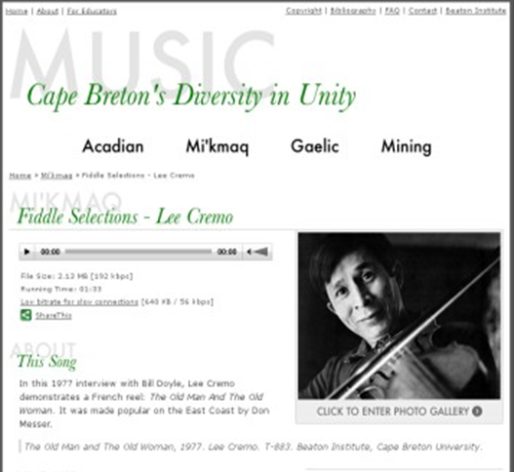
MUSIC: Cape Breton’s Diversity in Unity Project - 2010
Infrastructure and Skills Development
CMS (M2A) and raid server purchased
Digitization of textual, photographic and AV records
External hosting of static web site
Partners:
Heritage Canada
Centre for Cape Breton Studies
The Men of the Deeps
NS Highland Village Museum
La Société Saint-Pierre
Tradition Bearers
NS Department of Education
Notes:
This year we also participated in the NS Newspaper Digitization Project that others will address in more detail.
2009-10 – The MUSIC: Cape Breton’s Diversity in Unity project was a large and complex project including different communities, languages, tradition bearers, heritage institutions, and music experts.
We learned a great deal about partnering and collaboration.
Over 340 items were digitized with the assistance of the Centre for CB Studies and also Media Preserve with over 130 tracks made available on the website.
We purchased M2A through funding (Heritage Canada: Partnerships Fund) for this project, which is a content management system from MINISIS a Canadian company.
The project provided us with improved audio digitization standards and processes and it has been a truly positive project from the perspective of access and preservation.

Slide 7
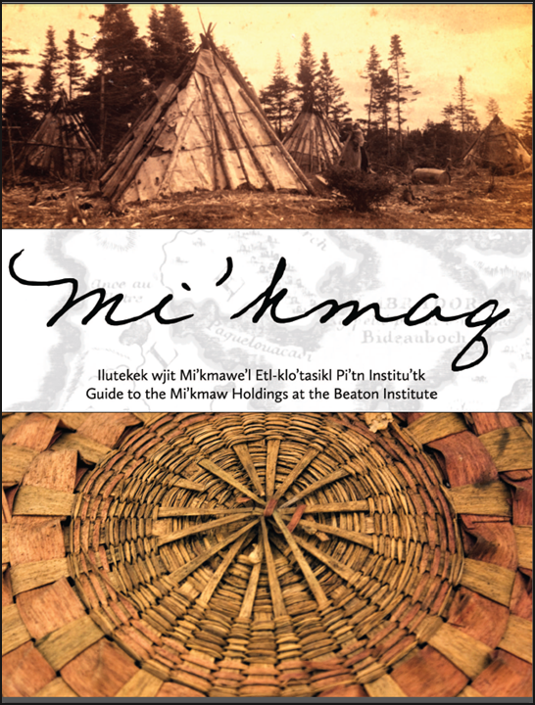
Beaton Institute Guide To the Mi’kmaq Holdings - 2011
Meeting Objectives:
Legacy data migrated
M2A database use to create finding aid
Meeting needs of our parent-body CBU and First Nations student body
Partners:
NADP
Cape Breton University Press
Mi’kmaq Resource Centre
Notes:
2010 – The Guide to the Mi’kmaq Holdings, with funding through National Archival Development Program, really started to test data entry and report generation of the content management system. We were able to recommend a number of changes to MINISIS through this process and also worked with CBU Press to create published copies for distribution in schools and other stakeholder organizations.
2011- This year we also digitized the recordings of the Cape Breton Chorale, we gained experience in our Content Management System (M2A) and helped a community organization celebrate its 50th Anniversary with the launch of a listening library. We received funds from NADP, the McLennan Foundation and the Congregation of Notre Dame.
We received funding from the McLennan foundation to work with the Holy Angels Convent records-as the convent closed we received a portion of the archival holdings. The Congregation de Notre Dame also provided support for the project.
Around this time we began to start using Flickr, although we’ve been slow to use social media. We needed a way to share content online and provide quick access for requests. We are using Flickr more often and have had good feedback. This was also the tipping point year when we started to use the database M2A more for description entry and in house searching. Digitization policies and procedures started to be developed formally and storage became a high priority.

Slide 8

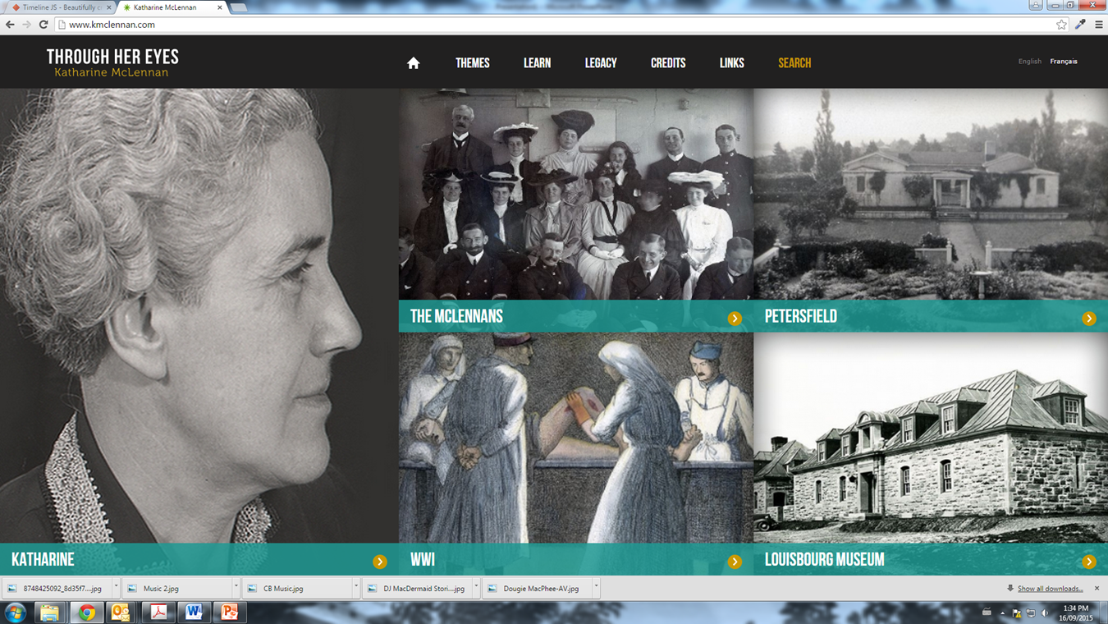
Through Her Eyes: Katharine McLennan Virtual Exhibit 2012-2013
Meeting Objectives and Sharing Expertise:
Digitized multiple formats using new digitization policies and procedures of multiple organizations.
Single access portal to Katharine McLennan’s documentary heritage residing in local archive, museum and library.
Partners:
SDI Funding
McConnell Library
Fortress Louisbourg NHS & Association
Heritage Canada
Enterprise Cape Breton Corporation
NS Department of Education
Notes:
2012:
The Beaton Institute archives, Cape Breton Regional Library – James McConnell Memorial Library and Fortress of Louisbourg partnered to develop and launch a virtual exhibit documenting the life and accomplishments of Katharine McLennan. Katharine McLennan is credited with the bringing to national awareness the history and in situ cultural resource of Fortress Louisbourg. The virtual exhibit will make available to all Canadians, through archival documents, photographs and art, Katharine’s life as an artist, a World War I nurse, historian and the first Curator of Fortress Louisbourg. The exhibit has been included in the program of events for Louisbourg300 celebrations.
This site used the CMS as a dynamic backend database – something we were not able to achieve with the Music project.

Slide 9
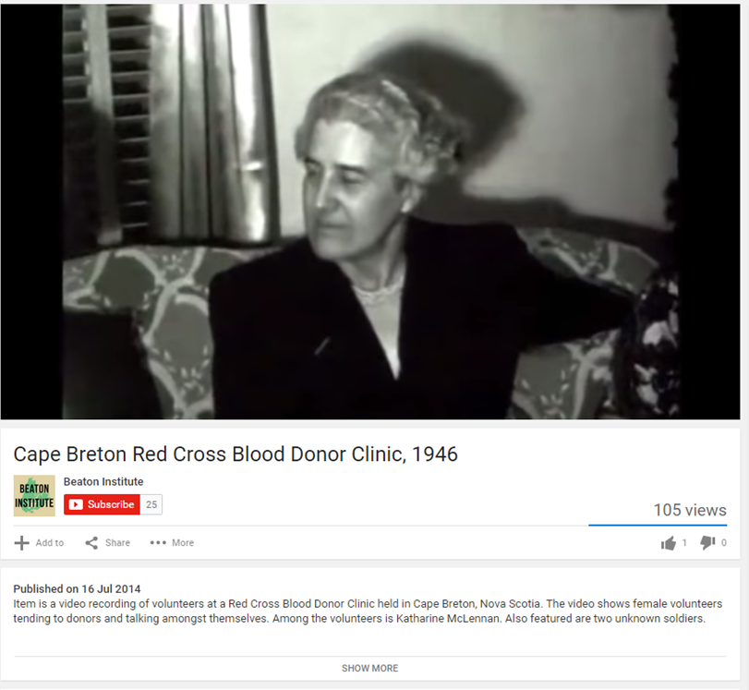
Through Her Eyes: Katharine McLennan Virtual Exhibit- Film Digitization
New formats
Outsourced digitization services
New skills
Provision of access to lost footage
Partners:
McConnell Library
Katharine McLennan Virtual Exhibit Team
Media Preserve
Notes:
It was also through this project that we trialed film digitization - outsourcing was required but we also starting using YouTube for viewing purposes. So, film is still a challenge. This is an area for future collaboration.
2013 – Digital Archivist position was confirmed for a one year term (she is still with us).
The position is instrumental as we establish proactive digital preservation strategy, creating better organization for existing digital content, manage storage, establish social media tools and work with the CMS.

Slide 10
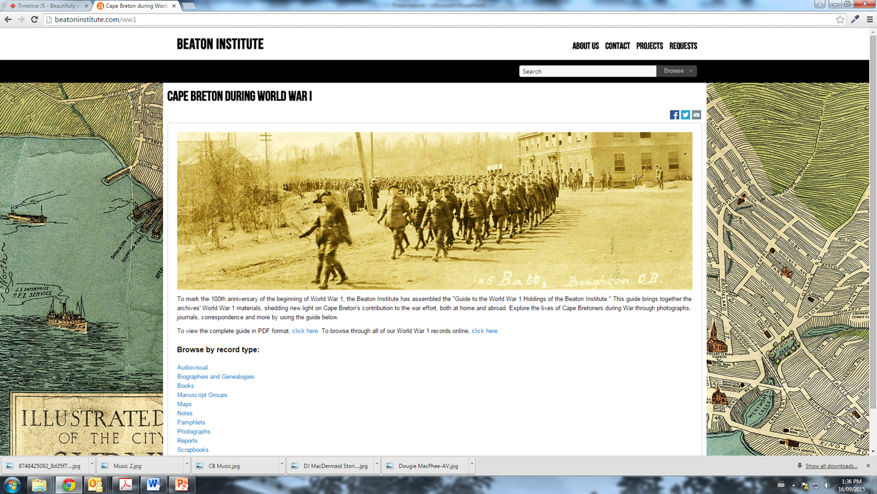
World War I Project: 2014 - 2015
Meeting access objectives
Initial project using AtoM
Trialed the project function of AtoM
Participation in provincial catalogue initiative - uploaded content to MemoryNS
Partners
PADP
Young Canada Works
Council of Nova Scotia Archives
Notes:
2014
While it is only six years since our first project - the field is changing quickly and staying abreast of practices, software is proving a challenge.
In the archival world AtoM replaced Eloquent as the provincial content management system, Gold CD no longer a required preservation standard, and questions such as is RAD in its current iteration needed if standardized CMS are being used?
In 2013 a One Time Emerging Culture and Heritage Initiative funding allowed for greater server space, as well as appropriate back-up for large scale files through the purchase of a NAS server and a site licencse for AtoM.
Our WWI project, completed with the support of the PADP, was our initial AtoM project. We trialed the project of AtoM using the subject tagging function with great success. We have since used the function for a Guide to our Black NS Holdings, and Eastern European Holdings.

Slide 11

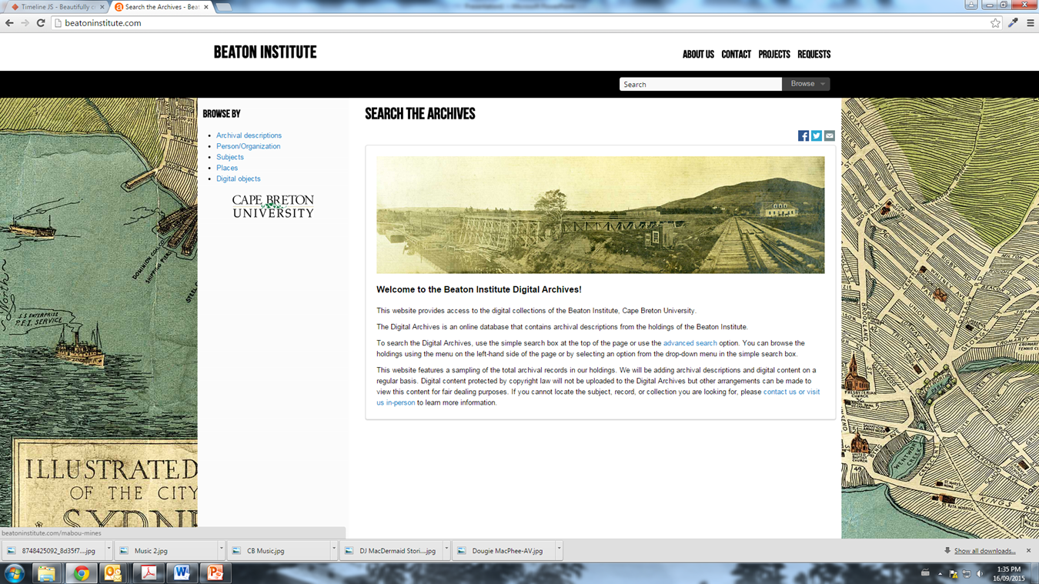
Beaton Institute Digital Archives - 2015
Meeting long term goals for access:
CMS and public interface launched
Ability to participate in provincial (MemoryNS) and national (ArchivesCanada) catalogues
We bring essential skill sets to partnered digital projects
Have developed policy & procedures
Have infrastructure in place – onsite AV digitization (excluding film), textual and photographic digitization, CMS, web interface, raid server and LTO.
Continuing goal to address legacy data
Sum total of all the incremental steps and projects – a new reference tool accessible globally.
Notes:
As an archives we had been striving to evolve the way we work – not merely to dabble or experiment with projects – but it has been the project-by-project approach that was doable and it is the culmination of our skills development our infrastructure development, digitization, re-description, etc that brought about the 2014 launch of our Digital Archives.
Meeting long term goals for access:
CMS and public interface launched
Ability to participate in provincial (MemoryNS) and national (ArchivesCanada) catalogues
We bring essential skill sets to partnered digital projects
Have developed policy & procedures
Have infrastructure in place – onsite AV digitization (excluding film), textual and photographic digitization, CMS, web interface, raid server and LTO.
Continuing goal to address legacy data
Sum total of all the incremental steps and projects – a new reference tool accessible globally.

Slide 12
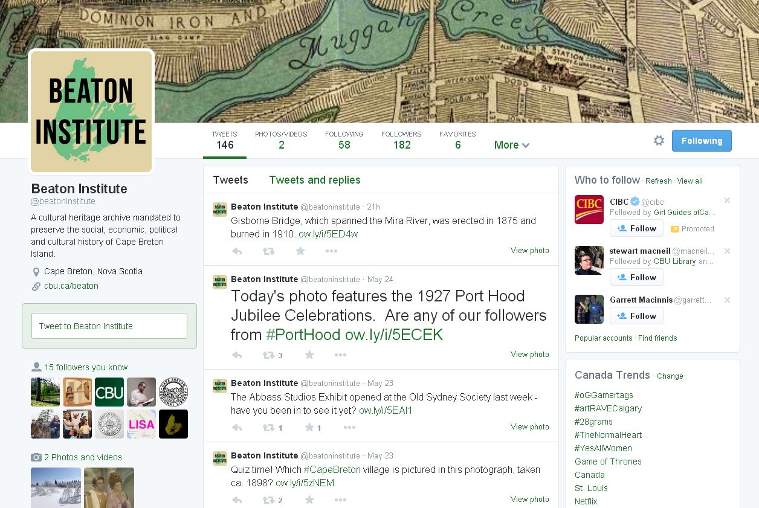
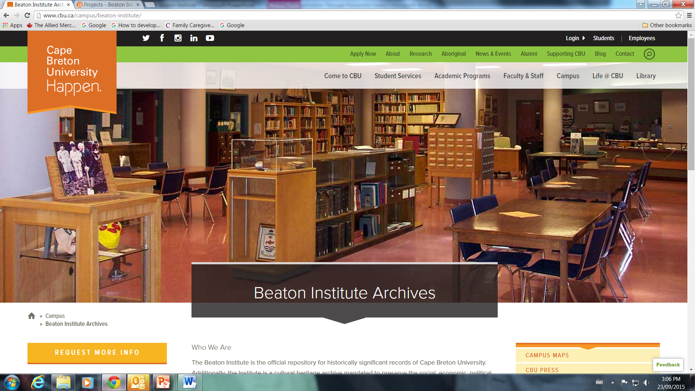
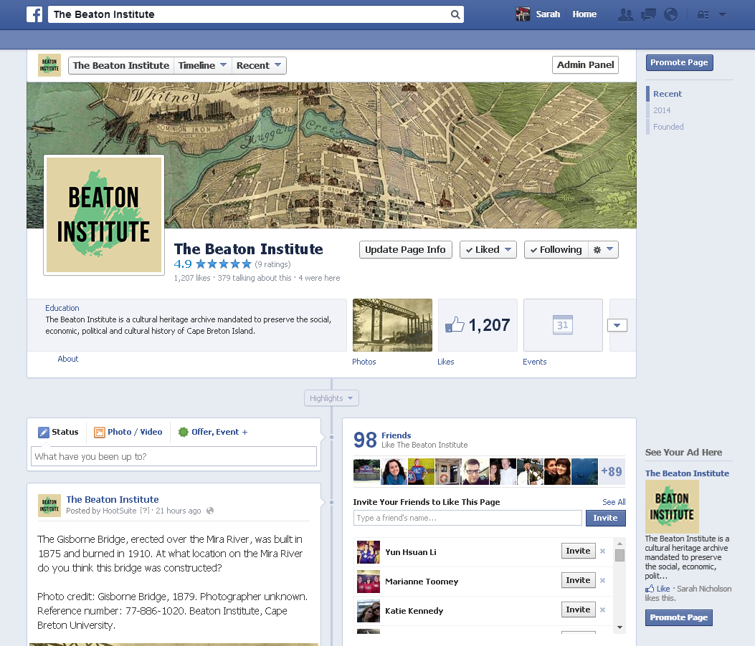
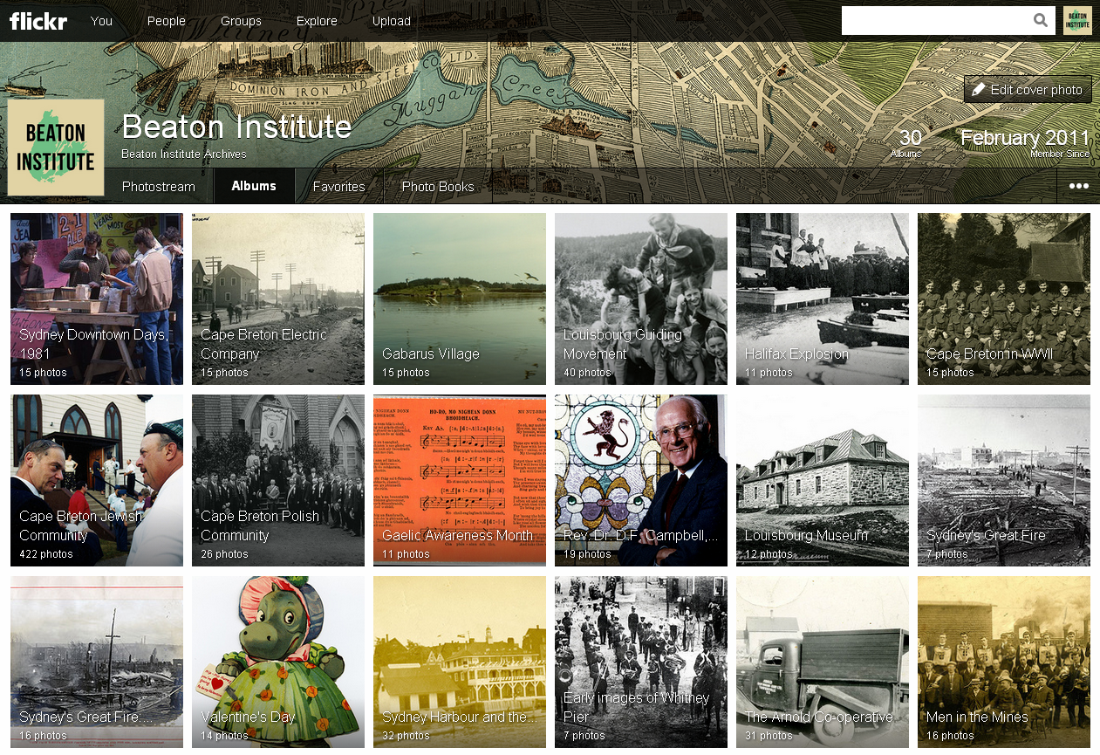
Living Digital Initiatives
Flickr:
- 562,270 views (since February 2011)
- Most popular “Lobster Factory Workers” 2,425 views
Twitter:
- 675 followers with 780 tweets
Beaton institute Digital Archives Website:
- 15,000 users with 204,000 page views (11 pages per session average)
- 9,771 archival descriptions; 573 authority records; 141 subjects. 157 geographic locations; 2,715 digital objects
Facebook:
- 3413 likes with 28 day reach of over 50,000 people
- engagement rates vary but have reached 80% on certain posts
Notes:
Added benefits of online presence…
more faculty of aware of our initiatives and continue to write the Beaton into their funding applications
digital content makes it easier to reach out to the public through social media
we benefitted from a recent CRC in Ethnomusicology which included the purchase of an LTO system and made upgrades to the digitization lab.

Slide 13
Learnings:
Resources:
- Skills
- Knowledge
Infrastructure:
- Hardware
- Software
Professional environment:
- Standards
- Policy & Procedures
The evolution takes a plan, takes time, the participation of partners.
At the outset digitization was an access and preservation strategy but we now know that it is an acquisition, access and preservation strategy for archives.
The field is still developing – new standards, new platforms, new best practices.
Is this sustainable working alone?
How can we work together to bring everyone along?
Notes:
So in closing: some learnings gained along the way
The evolution takes a plan, takes time, the participation of partners.
At the outset digitization was an access and preservation strategy but we now know that it is an acquisition, access and preservation strategy for archives.
The field is still developing – new standards, new platforms, new best practices.
Is this sustainable working alone?
How can we work together to bring everyone along?

Slide 14
Learnings
Partners: Associations CNSA, ANSM, NSLA
Funding support:
Access to hardware, software, storage
Leadership Institutions: NSA, NSM, Libraries
The evolution takes a plan, takes time, the participation of partners.
At the outset digitization was an access and preservation strategy but we now know that it is an acquisition, access and preservation strategy for archives.
The field is still developing – new standards, new platforms, new best practices.
Is this sustainable…working alone?
How can we work together to bring everyone along?
Notes:
If we are to look at a provincial strategy – there need to be partners, leaders, the provision of infrastructure and the ongoing access to funding support to enable everyone to participate.

Slide 15
Thank you!
Catherine Arseneau
Director, Cultural Resources
Cape Breton University
T: 902 563-1326
E: catherine_arseneau@cbu.ca
www.cbu.ca/campus/beaton-institute/

