Slide 1
Domestic Thrillers
The enemy from within
Maureen Collier HPL

Slide 2
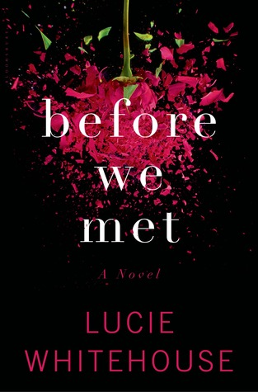
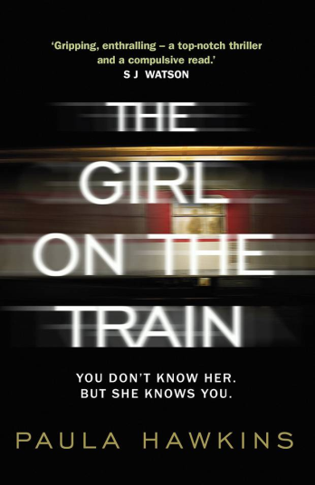
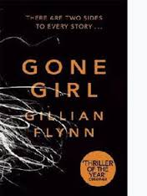
What’s in a name?
Domestic thrillers
Marriage thrillers
Domestic psychological suspense
Chick noir

Slide 3
Key elements and appeals
“books that play with our minds, that create a frisson of unease, that blend creepiness generated by the horror genre with the tension inherent in suspense” “characters trapped within their own personal nightmares” Joyce Saricks

Slide 4
Key elements and appeals
Commonalities of plot and characters
A couple, often married sometimes not
An established relationship with comfortable home and children
Alternating viewpoints
Secrets, many many secrets
Pacing – fast vs leisurely

Slide 5
Key elements and appeals
Commonalities of plot and characters
Unreliable narrators
Ending – unhappy, uncertain
Relatable situations
Adrenaline and Emotion
Seriously flawed characters
Intellectual component – what would you do?

Slide 6
Chick Lit vs Chick Noir
Chick Lit
Chick Noir
This is so my life, this just happened to me!
Quirky, relatable, fun characters
Empowerment, growth, and change
Could this happen to ME?
Flawed, dark, sometimes evil characters
Controlling the situation with violence and deception

Slide 7
Suggested Reads
Gone Girl by Gillian Flynn
The Husband’s Secret by Liane Moriarty
The Silent Wife by A.S.A. Harrison
Broken Harbour by Tana French
Before I Go to Sleep by S.J. Watson
How to Be a Good Wife by Emma Chapman
You Should Have Known by Jean Hanff Korelitz
Season to Taste by Natalie Young
Before We Met by Lucie Whitehouse
Under Your Skin by Sabine Durant

Slide 8
Suggested Reads
Close My Eyes by Sophie McKenzie
Dear Daughter by Elizabeth Little
Apple Tree Yard by Louise Doughty
Keep Your Friends Close by Paula Daly
The Daylight Marriage by Heidi Pitlor
The Dinner by Herman Koch
The Kind Worth Killing by Peter Swanson
He’s Gone by Deb Caletti
The Burning Air by Erin Kelly
The Girl on a Train by Paula Hawkins
A Small Indiscretion by Jan Ellison

Slide 9
Suggested Reads
Threats by Amelia Gray
Mother Mother by Koren Zailckas
Luckiest Girl Alive by Jessica Knoll
The Pocket Wife by Susan Crawford
Entwined With You by Syliva Day
Monday’s Lie by Jamie Mason

Slide 14
Current Trends in Science Fiction
Kristina Parlee
Collection Development Librarian (Adult)
Halifax Public Libraries

Slide 15
What do you think when you hear Science Fiction?
“…you might say that science fiction is escape into reality… the origin of man; our future. In fact I can’t think of any form of literature which is more concerned with real issues, reality.” Arthur C. Clarke
“People forget that it's not just about outer space but very much also about inner space.” – Erebeon on Reddit
"There's a fine line between a superpower and a chronic medical condition." — Soon I Will Be Invincible by Austin Grossman

Slide 16
What is Science Fiction (and what isn’t it)?
Related to but different from Fantasy
Science not magic: speculative
possible (although often future) worlds:
moral/ethical/philosophical questions are often at the centre
range of styles and tones

Slide 17
Who Reads Science Fiction and Why?
Readers are able to accept settings and characters that do not exist in our world.
Literature of questions
An “intellect genre” according to Joyce Saricks

Slide 18
Today: SciFi in the Mainstream
Art reflects life
Ongoing impact of genreblending
Geek-cool and nerd-chic
Influence of graphic novels
TV and film
In general the appetite for and acceptance of Science Fiction themes seems to be increasing.

Slide 19
Current Trends

Slide 20
Dystopias and Post-Apocalyptic
“Dear Science Fiction Writers: Stop Being So Pessimistic!” – article in Smithsonian Magazine 2012
Everything that can go wrong will: societal breakdown based on environmental, technological, economic, and/or plague based scenarios
Not a new trend but one that is still popular
One that was also popular in fantasy & horror

Slide 21
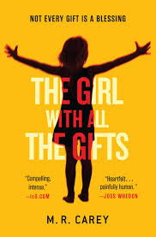
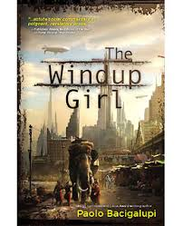
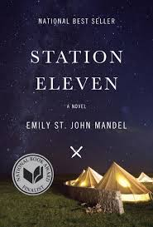
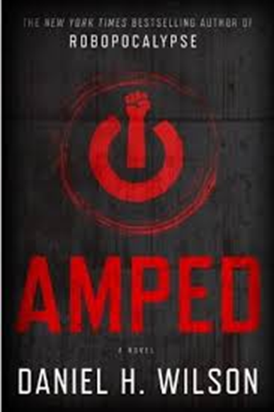
Examples of Dystopian/Post-Apocalyptic

Slide 22
Slipstream and The New Weird
Closely related & hotly debated stream of SF
Combines elements of SF, Fantasy and horror
Many authors not normally associated with SF are found in these genres.
New weird – like slipstream but weirder?
Slipstream – The literature of “cognitive dissonance”. Like new weird but more post-modern?

Slide 23
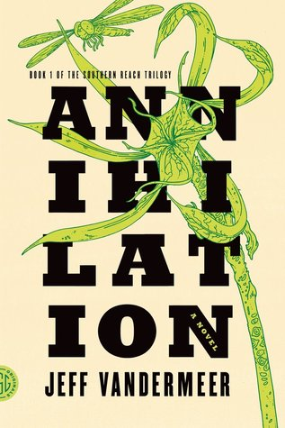
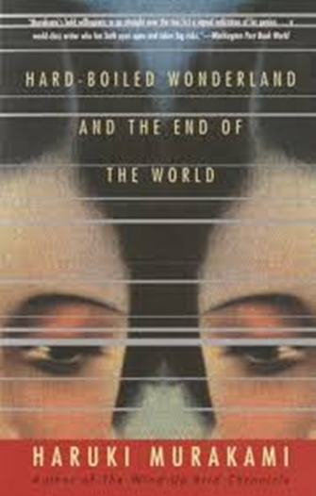
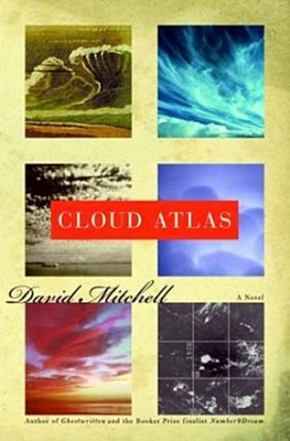
Examples of New Weird/Slipstream

Slide 24
Increased Diversity
Growth in number and prominence of books by women, people of colour and the GLBTQ community
Growth in themes that reflect those POVs and issues related to the communities.
Hugo Awards and the Sad Puppies

Slide 25
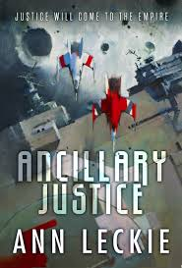
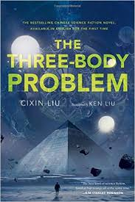
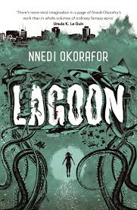
Examples of Increased Diversity

Slide 26
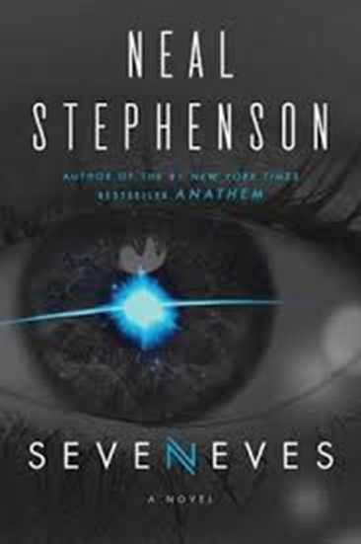
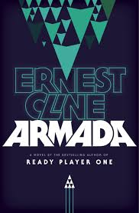
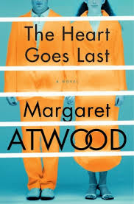
Other Current Popular Titles to Know

Slide 27
Welcome
to
New Adult Fiction!
Julia Khodos
Halifax Public Libraries

Slide 28
History
New Adult (NA) fiction is a developing genre of fiction with protagonists in the 18–30 age bracket.
The term originated with a writing contest hosted by St. Martin’s Press in 2009.
“St. Martin’s Press is actively looking for great, new, cutting edge YA with protagonists who are slightly older and can appeal to an adult audience. Since twenty-somethings are happily reading YA, St. Martin’s Press is seeking YA that can be published and marketed as adult; kind of an ‘older YA’ or ‘new adult.’ ”

Slide 29
“Beyond Wizards and Vampires, to Sex” ~ New York Times, 2012
“New Adult”: The Next Big Thing?”~ Writer’s Digest, 2013
“The ‘New Adult’ Genre Is Still Condescending and Pointless” ~ Flavorwire, 2014
“New adult earns shelf space in bookstores” ~ Globe and Mail, 2014
“ “Fast-selling ‘new adult’ genre vying for shelf space in bookstores” ~ Globe and Mail, 2014
“New Adult: A Book Category For Twentysomethings by Twentysomethings” ~ Publishers Weekly, 2014

Slide 30
Who are New Adults?
“…the transition from teen to adult doesn’t happen overnight. There’s a period of time where adulthood feels like a new pair of shoes. The expectations of independence and self-sufficiency are still new, still being broken in. New Adults are the people who have just begun to walk in those shoes; New Adult fiction is about their blisters and aches.” ~ NA Alley Blog.

Slide 31
NA or YA
18-25 years old
Independent
Adult responsibilities
Physical and emotional focus in intimate scenes
Think about the future
How do I become the person I want to be?
14-18 years old
Still dependent
Coming out of age
Emotional focus in intimate scenes
Think about present
Who I want to be?

Slide 32
Characteristics and Appeal
College settings
Characters with issues ranging from history of abuse, anger management issues, and troubled family lives.
First-person narration
Contemporary Romance
Fast-paced
Emotionally-intense story lines
Dramatic, soap-opera-like plots

Slide 33
Protagonists
She is “a quiet, studious bookworm who would go to bed at a decent hour. A non-partier who would not bring a parade of boys through our room, or make it the floor headquarters for beer pong.” – from “Easy” by Tammara Webber.

Slide 34
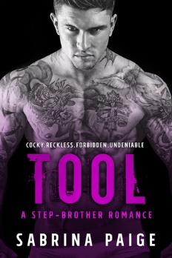
Protagonists

Slide 35
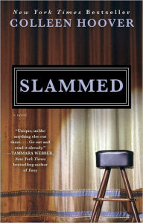
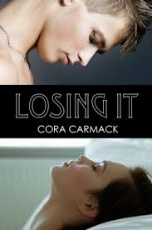
Key Authors and Titles
Jamie McGuire
Colleen Hoover
Cora Carmack

Slide 36
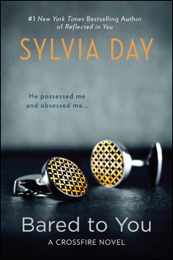
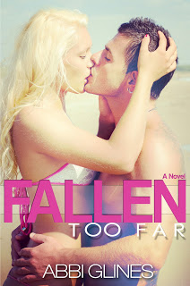
Key Authors and Titles
Tammara Webber
Abbi Glines
Sylvia Day

Slide 37
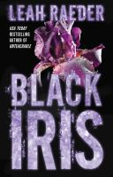
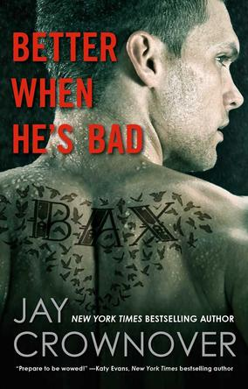
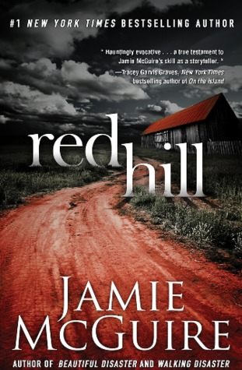
What’s next?
Subgenres:
Horror,
Erotic Romance
Suspense
Crime Fiction
More Diversity
Non-fiction

Slide 38
References
Beckett, Sandra L. (2009). Crossover Fiction: Global and Historical Perspectives. Routledge.
Wetta, M. (2014). What is New Adult, Anyway? Retrieved from Novelist: https://www.ebscohost.com/novelist/novelist-special/what-is-new-adult-fiction-anyway
Genre Overview: New Adult. (2014). Retrieved from Massachusetts Library System: http://guides.masslibsystem.org/newadult
What is New Adult? (2015). Retrieved from NA Alley: http://www.naalley.com/2015/08/the-new-adult-niche.html
Young Adult vs. New Adult Literature: New literary genre or marketing stunt? (2014). Retrieved from http://www.sols.org/files/docs/develop/professionalinfo/training/workshopsupportmat/genre/youngadult_vs_newadult.pdf

