Slide 1
Academic Libraries
Susan Cameron
Interim University Librarian
Angus L. Macdonald Library
St.Francis Xavier University
September 25, 2015

Slide 2
What was done
Focused on specialized content
Unique Items in our Celtic Collection
University Archives
Coady Institute : extension story
Xaveriana
Local Material
Requests from patrons
Collaboration with :
Celtic Studies Department at X
Newspaper Digitization Initiative
Gaelic Community
Attempt at a province wide steering committee

Slide 3
Gaelstream: Mostly Audio Files- collection migrated to various media, prototype to current version, now needs refresh and new platform
Coady Extension Story: 50 Year Anniversary-multimedia, St.F.X. Archives
Am Braighe, Cuairtear Og Gaelach- Gaelic Nova Scotia Newspapers and Guysborough Journal

Slide 6
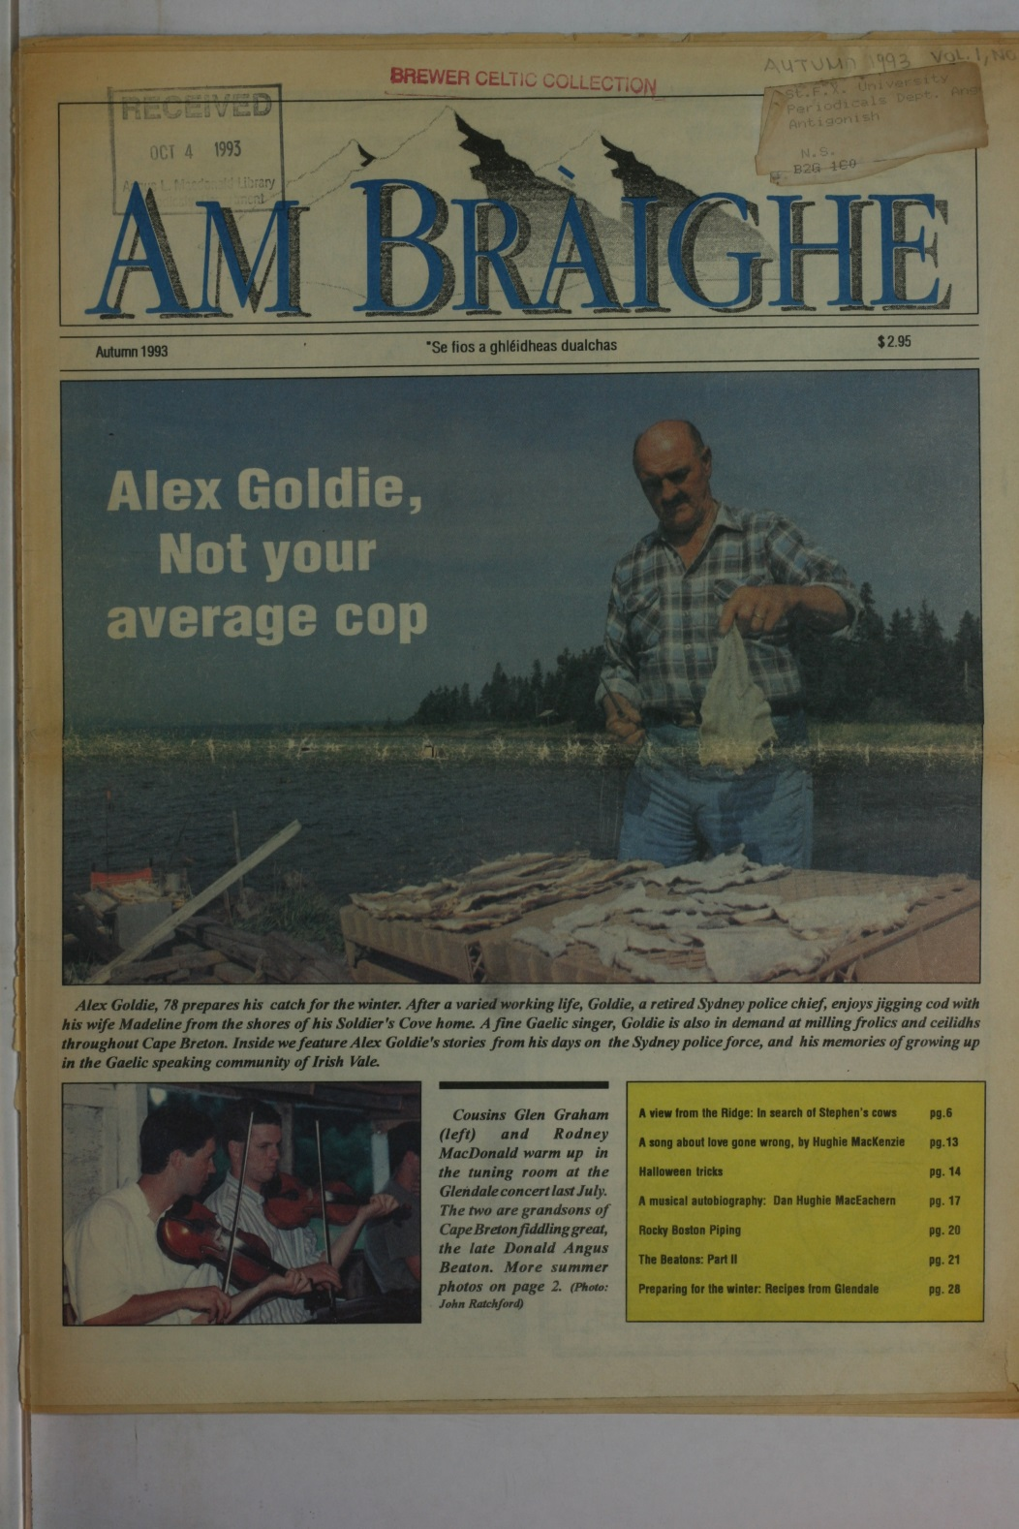
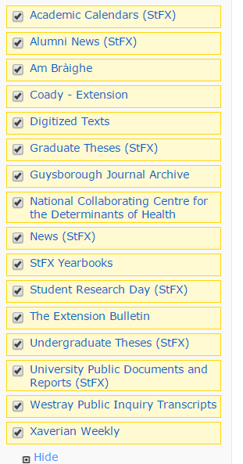

Slide 8
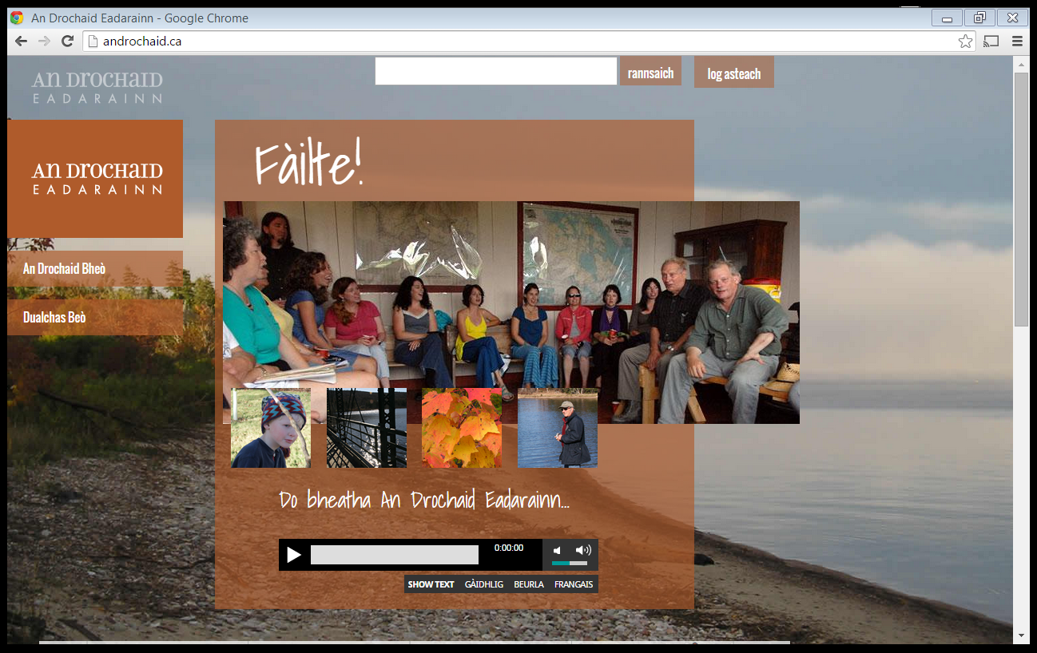
Multimedia interactive site

Slide 9
Constraints, challenges, realities
Not enough expertise with audio files
Limited grant applications
Copyright issues
Content DM limitations
Staffing and Skills issues:
Equipment issues
Lost staff

Slide 10
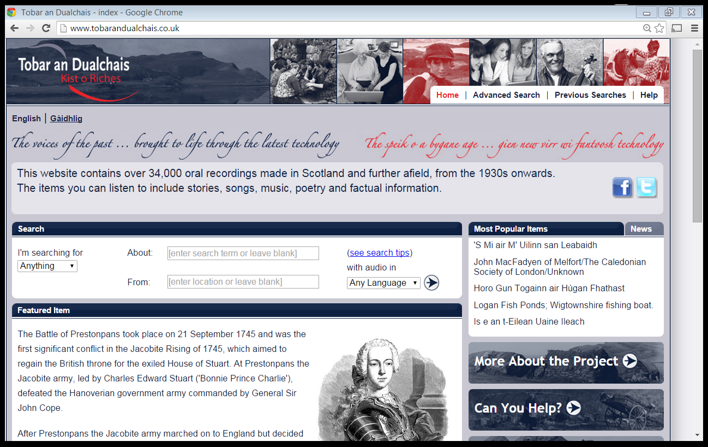

Slide 11
Create a Collaborative, interactive, multi-media Nova Scotia Gaelic Portal following the Europeana and
Tobar an Dualchais
models

